Slide 1

Guvi Galgotia’s 5-Day Internship Project Board
Power BI Internship Project
E-Commerce Sales Dashboard
Applying Data Analytics to Real-World Business Problems

Slide 2

Problem Statement & Objective
Problem Statement: Our client, an e-commerce organization, needed a robust business insights dashboard to effectively analyze their vast sales data. Existing methods lacked the interactivity and depth required for agile decision-making.
Project Task: Design and implement a comprehensive, interactive Power BI dashboard focused on sales performance, profit analysis, and operational efficiency monitoring.
Key Objective: Empower stakeholders with immediate access to critical data, enabling them to make informed, data-driven decisions by identifying trends, tracking key performance indicators (KPIs), and generating reliable forecasts.

Slide 3




Data & Methodology
Data Modeling & DAX Implementation
Dataset Acquisition & Cleaning
Established robust data models with appropriate relationships between tables. Created calculated columns and complex measures using DAX (Data Analysis Expressions) for advanced calculations and aggregations.
Utilised a multi-year e-commerce sales dataset (200+ rows across multiple tables). Performed extensive data cleaning and transformation using Power Query to ensure data integrity and usability.
Tools Utilized
Dynamic Visualizations & Interactivity
The entire project was developed leveraging Microsoft Power BI, with a strong focus on DAX for calculations and Power Query for data preparation and transformation.
Designed a range of dynamic visualizations including cards, bar charts, line graphs, donut charts, and map visuals. Integrated slicers, drill-down capabilities, and cross-filtering for enhanced user interaction.

Slide 4
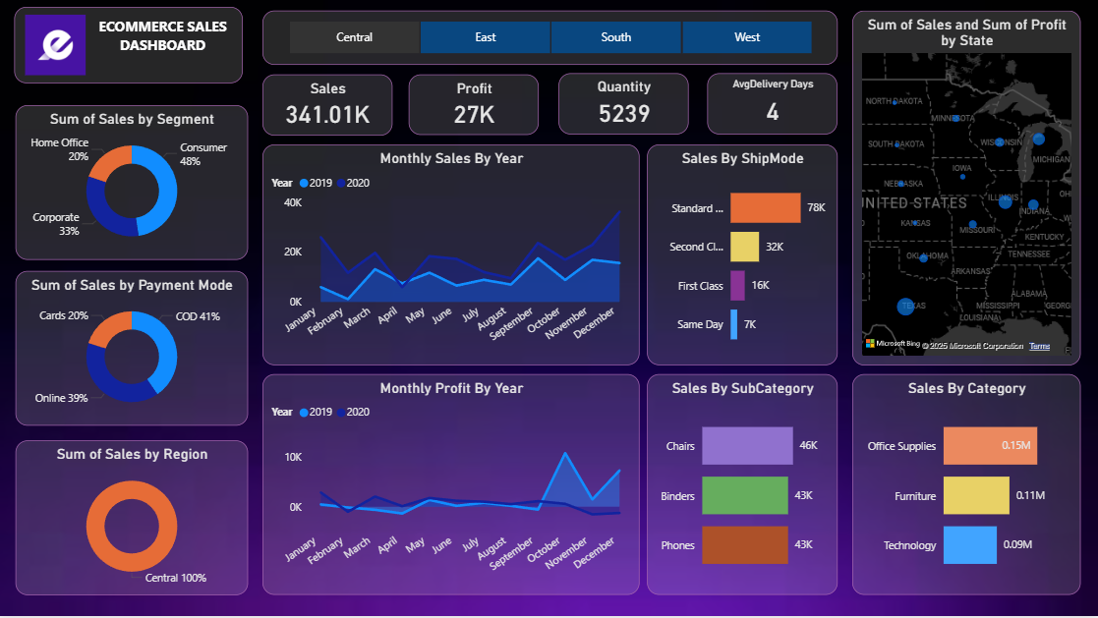

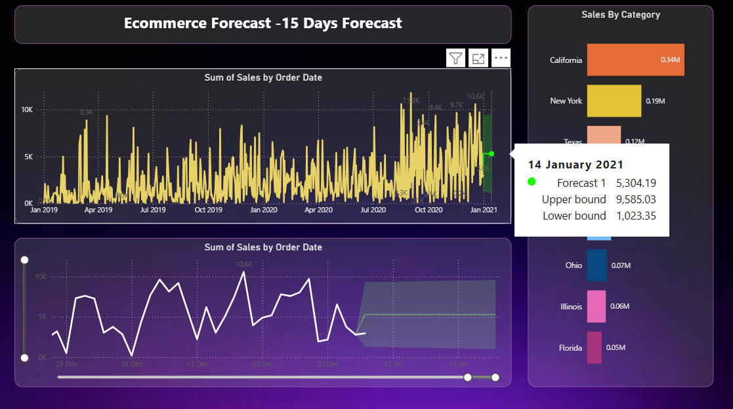
Dashboard Overview
Our interactive Power BI dashboard provides a holistic view of e-commerce performance. Key highlights include:
Key Performance Indicators (KPIs): Sales ₹1.57M | Profit ₹175K | Quantity Sold 22K | Average Delivery Time 4 Days
Segment Split: Consumer 48% | Corporate 33% | Home Office 19%
Top Regions by Sales: California (₹0.34M), New York, Texas
Payment Modes: Cash on Delivery (COD) 43% | Online Transactions 35% | Card Payments 22%

Slide 5
Key Insights & Business Value
The dashboard revealed critical insights enabling strategic business decisions:
Top Performing Categories
High-Value Subcategories
Office Supplies: ₹0.64M
Phones: ₹0.20M
Technology: ₹0.47M
Chairs: ₹0.18M
Furniture: ₹0.45M
Binders: ₹0.17M
Shipping Efficiency
Sales Trends & Forecast
Standard Class: Dominates with ₹0.33M in sales, highlighting customer preference for cost-effective shipping.
Consistent growth observed with pronounced seasonal peaks towards year-end, indicating predictable high-demand periods. Forecasts project continued positive growth trajectory.
These insights directly inform inventory management, marketing campaigns, and regional expansion strategies.

Slide 6
Learnings & Outcomes
1
Deepened Power BI Proficiency
Gained hands-on expertise in end-to-end Power BI development, including advanced data cleaning, robust data modeling, and complex DAX formula creation.
2
Interactive Dashboard Development
Successfully built a fully interactive dashboard featuring slicers, drill-downs, and integrated forecasting capabilities for dynamic data exploration.
3
Enhanced Analytical Skills
Developed critical problem-solving, analytical thinking, and effective data visualization skills, crucial for translating raw data into actionable business intelligence.
4
Industry-Ready Portfolio Project
This internship provided invaluable experience, strengthening industry-relevant skills and resulting in a tangible, portfolio-ready project showcasing practical data analytics application.
5
Delivered Actionable Insights
The project culminated in delivering clear, actionable insights that directly support the client's decision-making processes, demonstrating the real-world impact of data analytics.

